Slide 1
Automobiles SALES DATA
BY SMITA SINGH

Slide 2
PROBLEM STATEMENT
Over-Reliance on a Single Product Category
"Classic Cars" is the top-selling product, suggesting high dependence on one category.
Other product lines contribute less to revenue, limiting diversification.
Low Order Frequency & Customer Retention
Despite high total sales ($9.76M), the number of total orders (2,747) suggests low repeat purchases.
Suboptimal Pricing & Revenue Potential
The average order value ($3,553.05) suggests possible pricing inefficiencies.

Slide 3
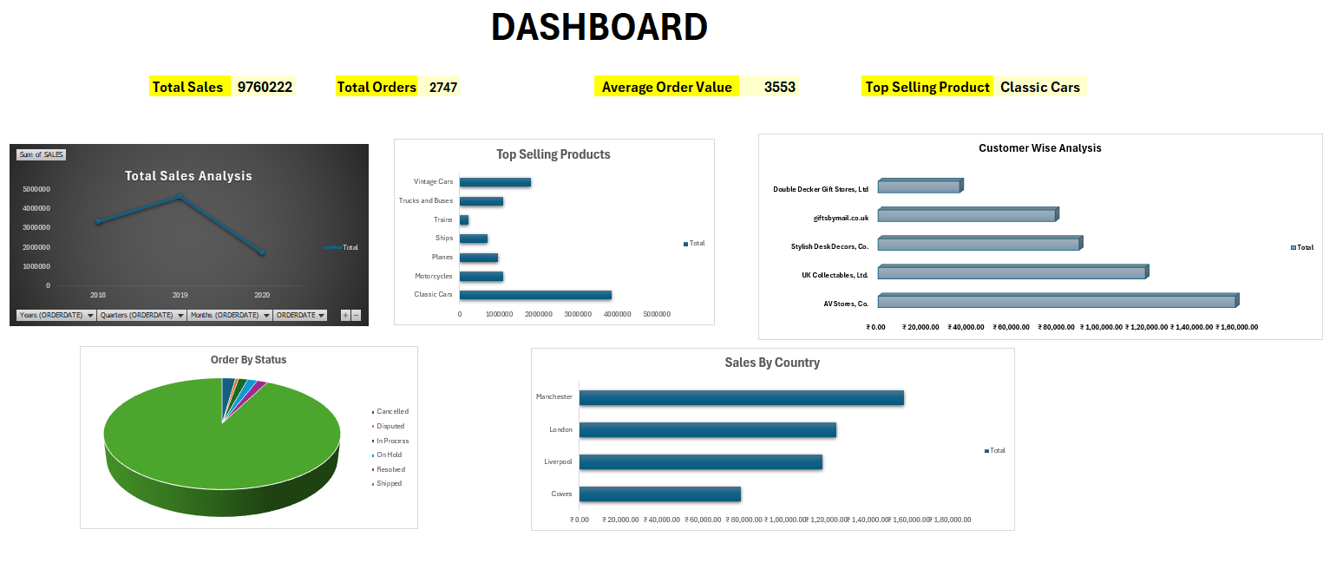

Slide 4
SOLUTION
1. Diversify Product Sales & Reduce Dependency on Classic Cars
Promote underperforming categories through targeted marketing campaigns.
Introduce bundle offers by combining slow-moving products with high-demand ones.
2. Increase Order Frequency & Customer Retention
Implement loyalty programs with discounts or reward points for repeat customers
Use purchase history to create personalized promotions and recommendations.
3. Optimize Pricing & Maximize Revenue Potential
Implement dynamic pricing strategies based on demand and seasonality.
Offer bulk purchase discounts to encourage larger order sizes.

Slide 5
Future Implication
This project was created using Microsoft Excel, utilizing its data analysis and visualization tools to identify key sales trends.
Excel helped in structuring and interpreting the data, allowing clear problem identification and solution development.
In the future, I will use Power BI with the same dataset to create interactive dashboards and real-time visualizations.
Power BI will enhance insights through dynamic filtering, automated data updates, and AI-driven analytics.
This transition will improve data-driven decision-making and make analysis more efficient and impactful.

Slide 6
THANK YOU

